Slide 1





G8T9 Y W L T C
Final Presentation
Christine | Lifu | Tee Yong | Wang Ting | Yu Liang

Slide 2



Agenda
Schedule
Bug Metric
Use of Git
Reflections

Slide 3
Schedule

Slide 4
Project Schedule
LEGEND
PLANNED
ACTUAL
Week 5 – Week 6
Week 7 – Week 8
Week 9 – Week 10
Week 11 – Week 13
W5
W6
W7
W8
W9
W10
W11
W12
W13
Iteration 1
Iteration 2
Iteration 3
Iteration 4
Iteration 5
Iteration 1
Iteration 2
Iteration 3
Iteration 4
Iteration 5
PLANNED
Complete 2 functions:
Login, Bootstrap
Basic UI Design
Finish all required functionalities
Develop additional features + UI design
Fix bugs, UI improvement
Final Presentation
ACTUAL
Complete 2 functions:
Login, Bootstrap
Basic UI Design
Fulfilled all except Round 2, Drop Section, Add Bid (Round 2), Admin View Results
Finish uncompleted tasks from iteration 2
Develop additional features
Debug
UI improvements
Bid Status
Finish UI and debugging
Final Presentation

Slide 5
Functionalities

Slide 6
Did you drop/add any functionalities?
We did not drop any functionalities
Yes, we added the following functionalities
Search
Timetable
Modal Box
Admin Interface (allowing admin to view all the SQL tables)
Admin is able to help students to amend their Bid and enrolled course.

Slide 7
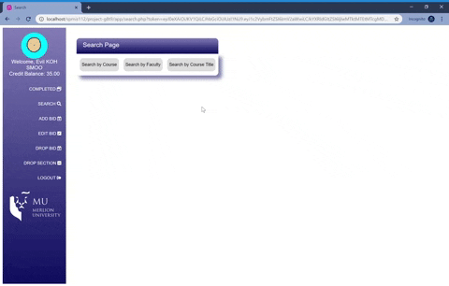
Additional Features: Search Function
Provides options of searching by Courses, Faculty, and Course Title.
Helps users to look for courses to plan for bidding

Slide 8
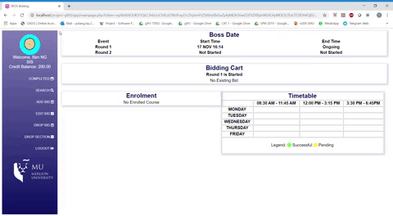
Additional Features: Time Table (Round 1)
Provides a clear overview of their bidding progress for the students
In round 1, yellow represent s“Pending”

Slide 9
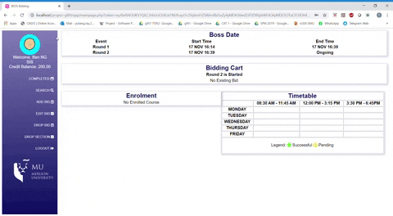
Additional Features: Time Table (Round 2)
Provides a clear overview for the students
In round 2, green represent that the bid is successful

Slide 10
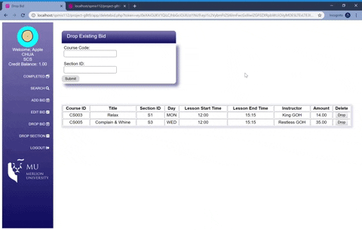
Additional Features: Modal Box
Error prevention: double confirming an action helps prevent mistakes from misclicks

Slide 11
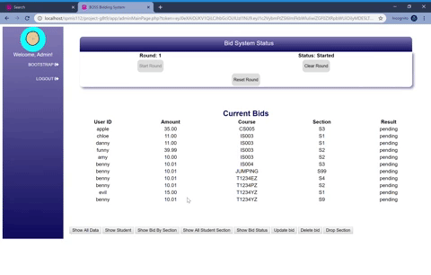
Additional Features: Admin Interface
Easy and effortless view of dump info

Slide 12

Additional Features: Admin Rights
Admin can update bid, delete bid, and drop section for a student

Slide 13
Did you use any PHP frameworks?
No, we didn’t use any framework throughout the whole project.

Slide 14
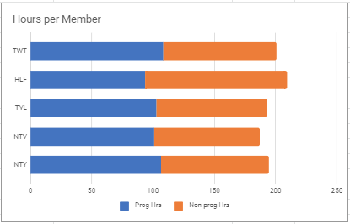
Breakdown of work
(Overview)
Approx ~190 hrs per member
Programming
Non programming
LIFU
93.7
115.4
WANG TING
108.3
92.1
CHRISTINE
101.2
85.9
TEE YONG
106.4
88.4
YU LIANG
102.9
90.3

Slide 15
Task Allocation (overview)
Iteration 1
Iteration 2
Iteration 3
Iteration 4
Iteration 5
LIFU
PM
Functionality (Rounds clearing, View Bidding Results)
Functionality (Round 2, Search)
Testing & debugging
Minutes taker
Testing & debugging
WANG TING
Functionality (Bootstrap) & UI
Minutes taker
PM
Functionality (JSON)
Extra Functionality (Timetable, Drop Section, Modal Box)
JSON Testing
UI programmer
UI programmer
CHRISTINE
Functionality (Bootstrap) & UI
Functionality (Add / Edit / Drop bid) Minutes taker
PM
UI programmer
UI programmer
TEE YONG
Functionality (Set up DAOs, Login)
Functionality (Rounds clearing, View Bidding Results)
Extra Functionality (Timetable, Drop Section, Modal Box)
JSON Testing
PM
Testing & debugging Minutes taker
YU LIANG
Functionality
(Set up DAOs, Login)
Functionality (Add / Edit / Drop bid)
Extra Functionality (Round 2, Search)
Minutes taker
Testing & debugging
PM
Notes:
Minutes taker

Slide 16
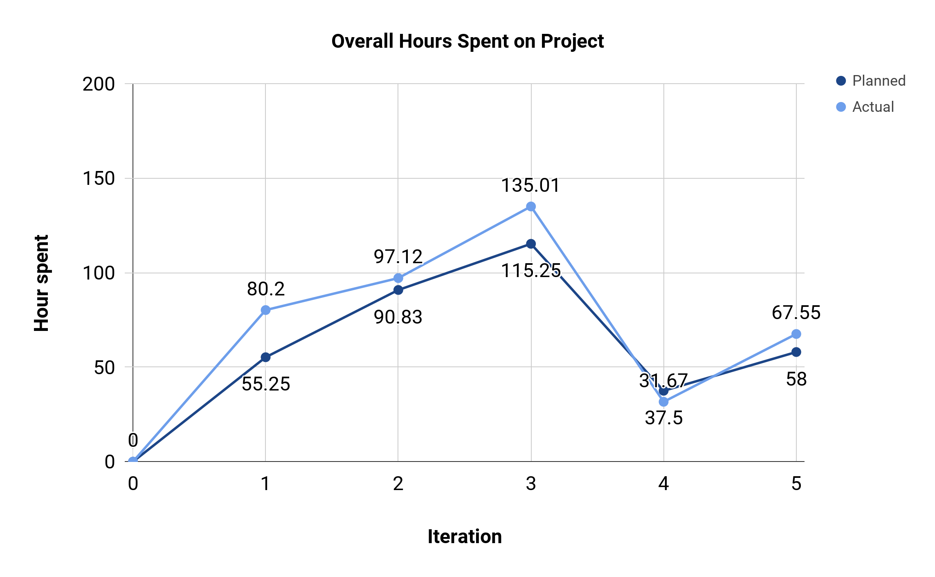
Detailed breakdown of Work
Iteration No. | Planned | Actual
0 | 0 | 0
1 | 55.25 | 80.2
2 | 90.83 | 97.12
3 | 115.25 | 135.01
4 | 37.5 | 31.67
5 | 58 | 67.55

Slide 17
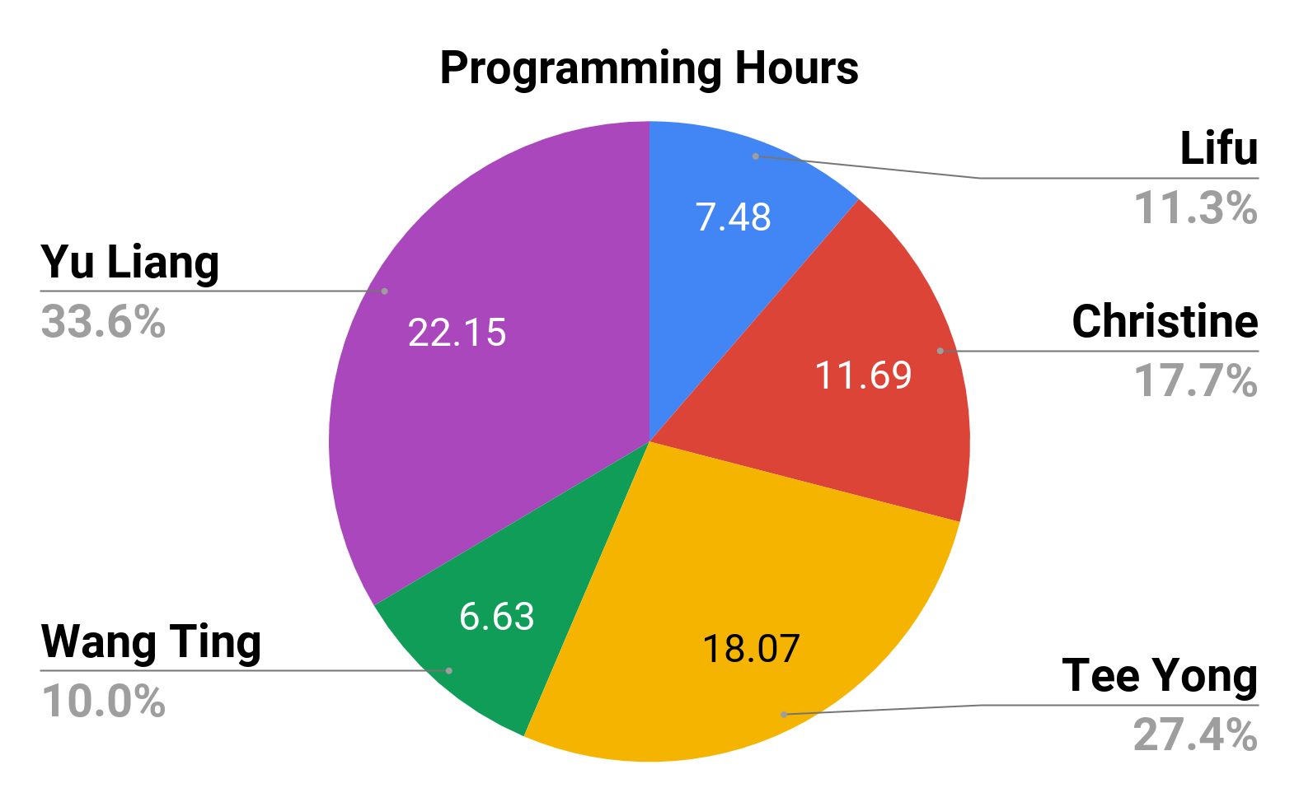
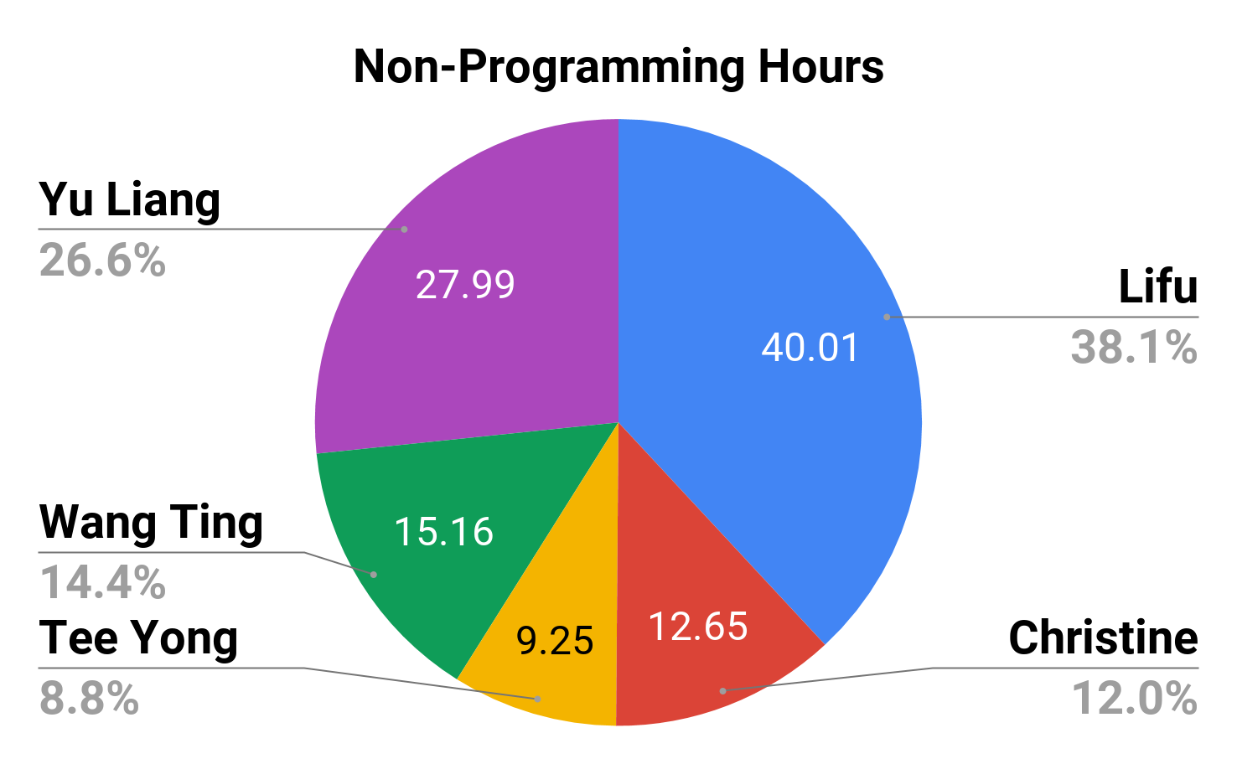
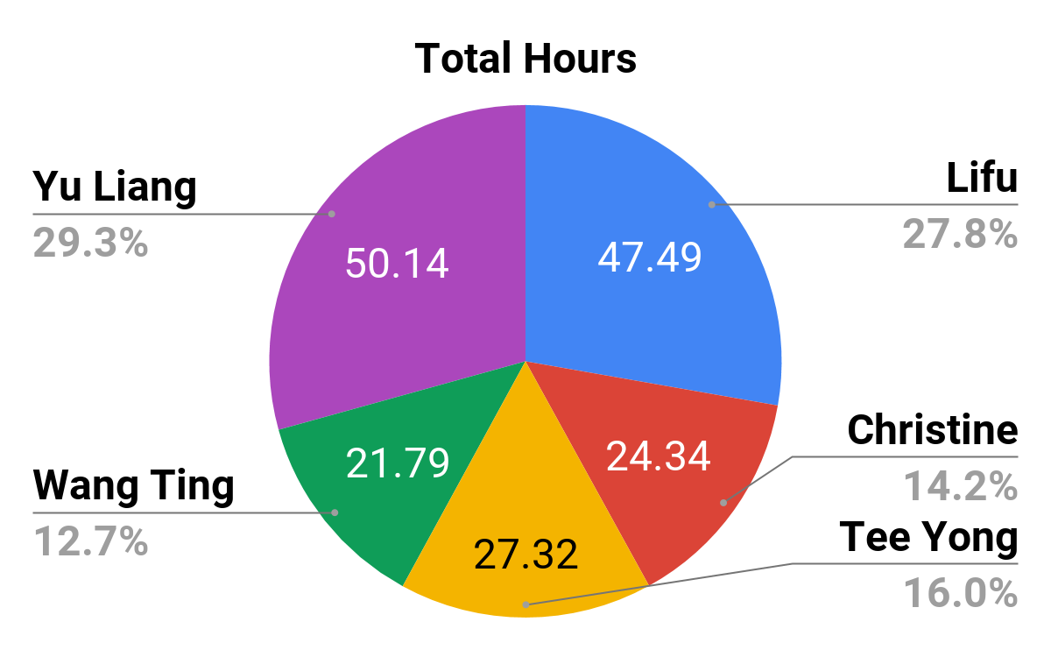
Breaking Down of Work (Iteration 1)
Iteration 1 | Team Member | Programming Hrs | Non Programming Hrs | Total Hours
 | Lifu | 7.48 (11.3%) | 40.01 (38.1%) | 47.49 (27.8%)
 | Christine | 11.69 (17.7%) | 12.65 (12.0%) | 24.34 (14.2%)
 | Tee Yong | 18.07 (27.4%) | 9.25 (8.8%) | 27.32 (16.0%)
 | Wang Ting | 6.63 (10.0%) | 15.16 (14.4%) | 21.79 (12.7%)
 | Yu Liang | 22.15 (33.6%) | 27.99 (26.6%) | 50.14 (29.3%)

Slide 18
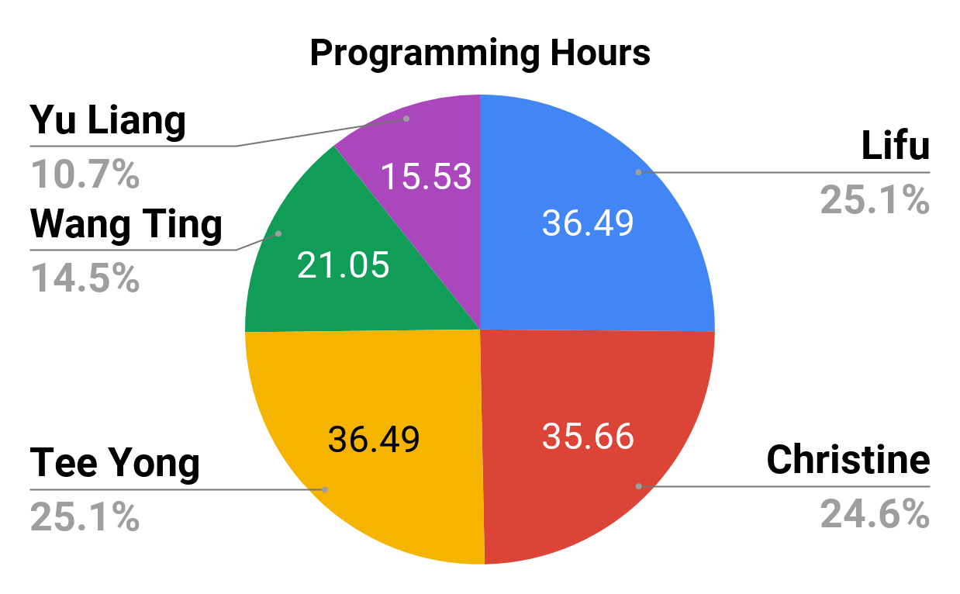
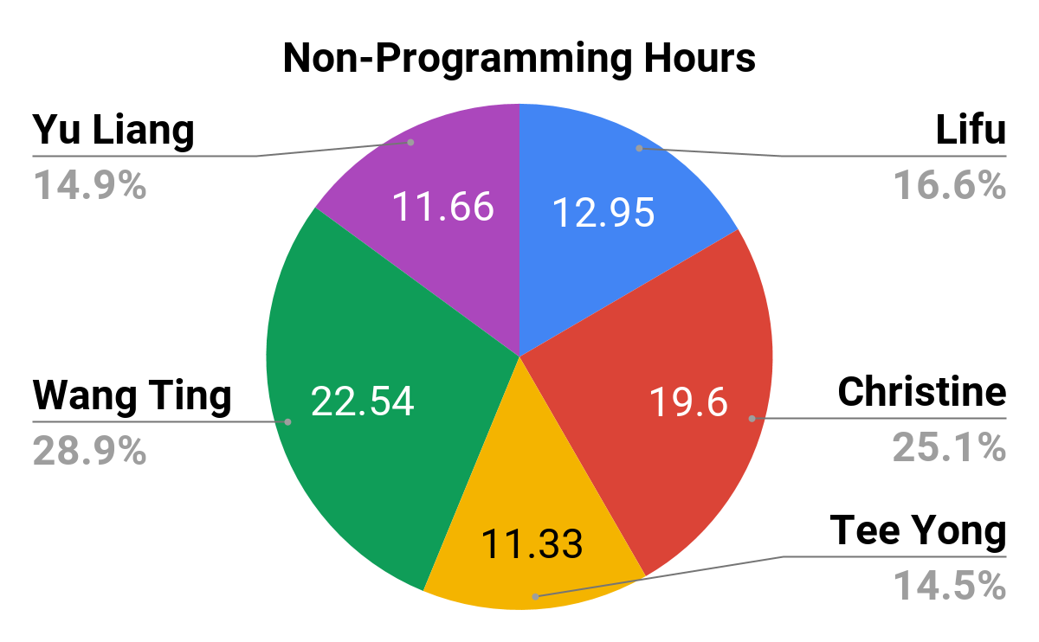
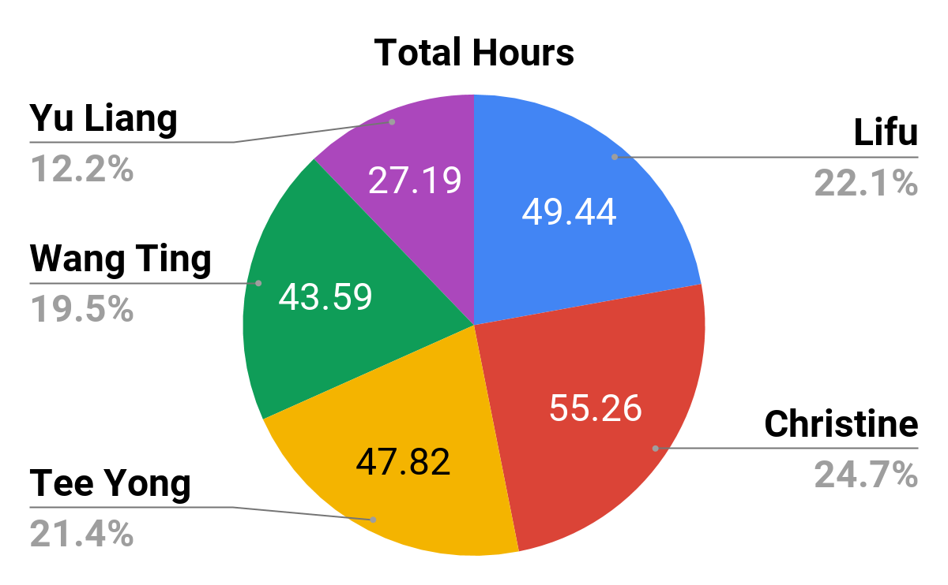
Breaking Down of Work (Iteration 2)
Iteration 2 | Team Member | Programming Hrs | Non Programming Hrs | Total Hours
 | Lifu | 36.49 (25.1%) | 12.95 (16.6%) | 49.44 (22.1%)
 | Christine | 35.66 (24.6%) | 19.6 (25.1%) | 55.26 (24.7%)
 | Tee Yong | 36.49 (25.1%) | 11.33 (14.5%) | 47.82 (21.4%)
 | Wang Ting | 21.05 (14.5%) | 22.54 (28.9%) | 43.59 (19.5%)
 | Yu Liang | 15.53 (10.7%) | 11.66 (14.9%) | 27.19 (12.2%)

Slide 19
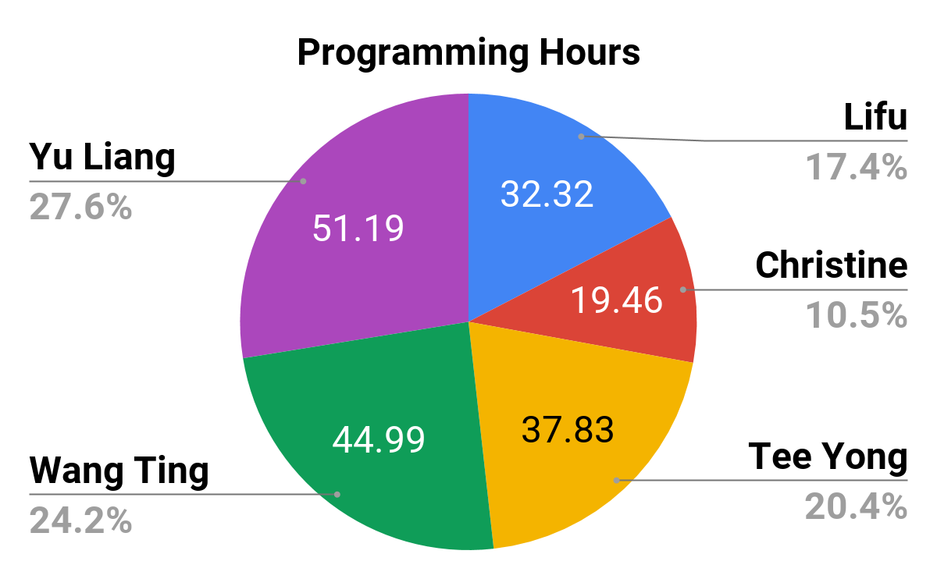
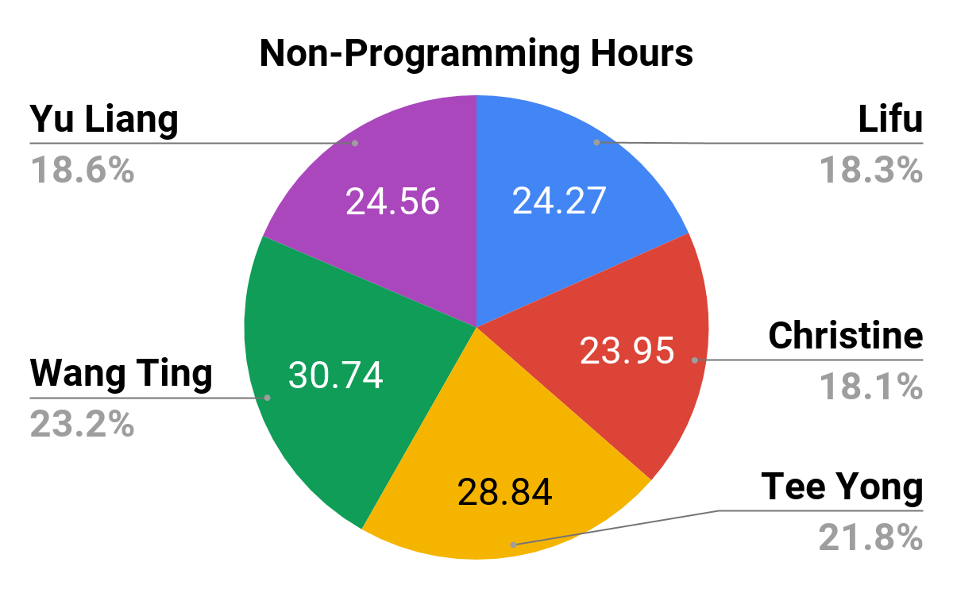
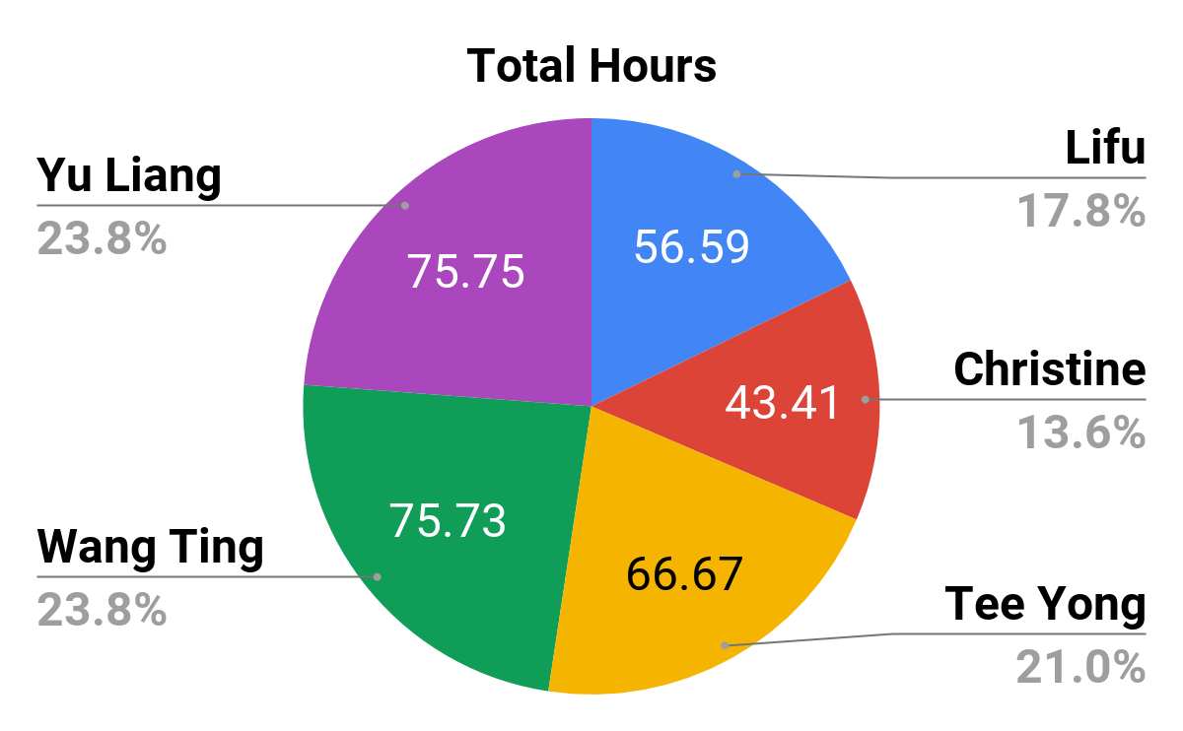
Breaking Down of Work (Iteration 3)
Iteration 3 | Team Member | Programming Hrs | Non Programming Hrs | Total Hours
 | Lifu | 32.32 (17.4%) | 24.27 (18.3%) | 56.59 (17.8%)
 | Christine | 19.46 (10.5%) | 23.95 (18.1%) | 43.41 (13.6%)
 | Tee Yong | 37.83 (20.4%) | 28.84 (21.8%) | 66.67 (21.0%)
 | Wang Ting | 44.99 (24.2%) | 30.74 (23.2%) | 75.73 (23.8%)
 | Yu Liang | 51.19 (27.6%) | 24.56 (18.6%) | 75.75 (23.8%)

Slide 20
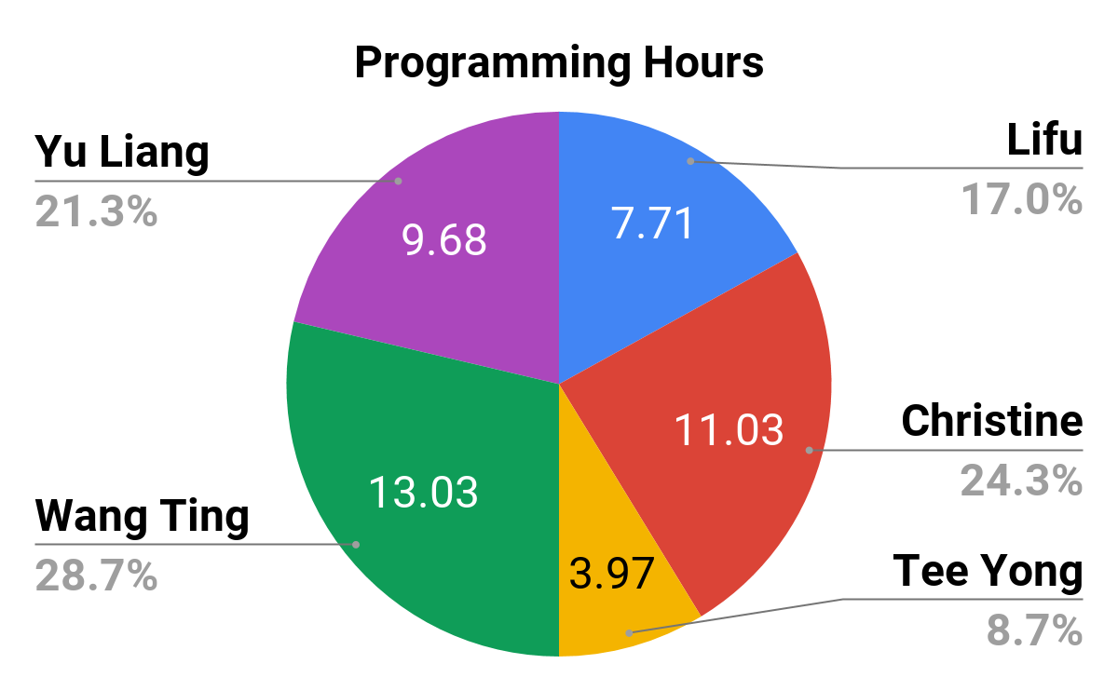
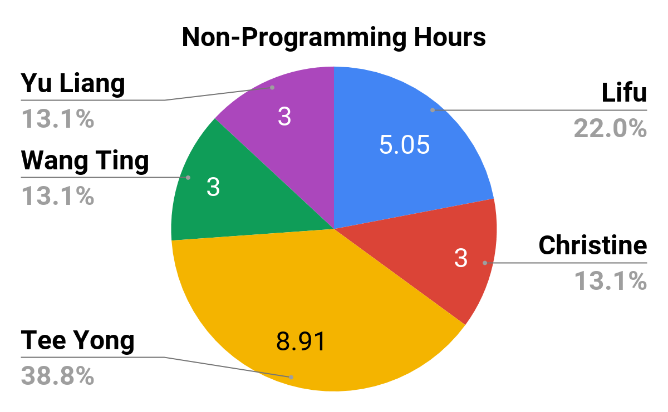
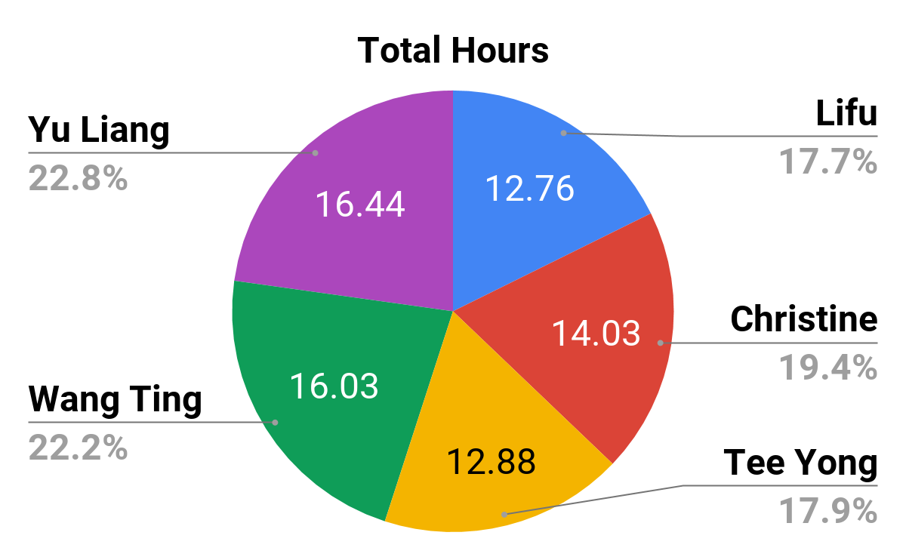
Breaking Down of Work (Iteration 4)
Iteration 4 | Team Member | Programming Hrs | Non Programming Hrs | Total Hours
 | Lifu | 7.71 (17.0%) | 5.05 (22.0%) | 12.76 (17.7%)
 | Christine | 11.03 (24.3%) | 3 (13.1%) | 14.03 (19.4%)
 | Tee Yong | 3.97 (8.7%) | 8.91 (8.91%) | 12.88 (17.9%)
 | Wang Ting | 13.03 (28.7%) | 3 (13.1%) | 16.03 (22.2%)
 | Yu Liang | 9.68 (21.3%) | 3 (13.1%) | 12.68 (22.8%)

Slide 21
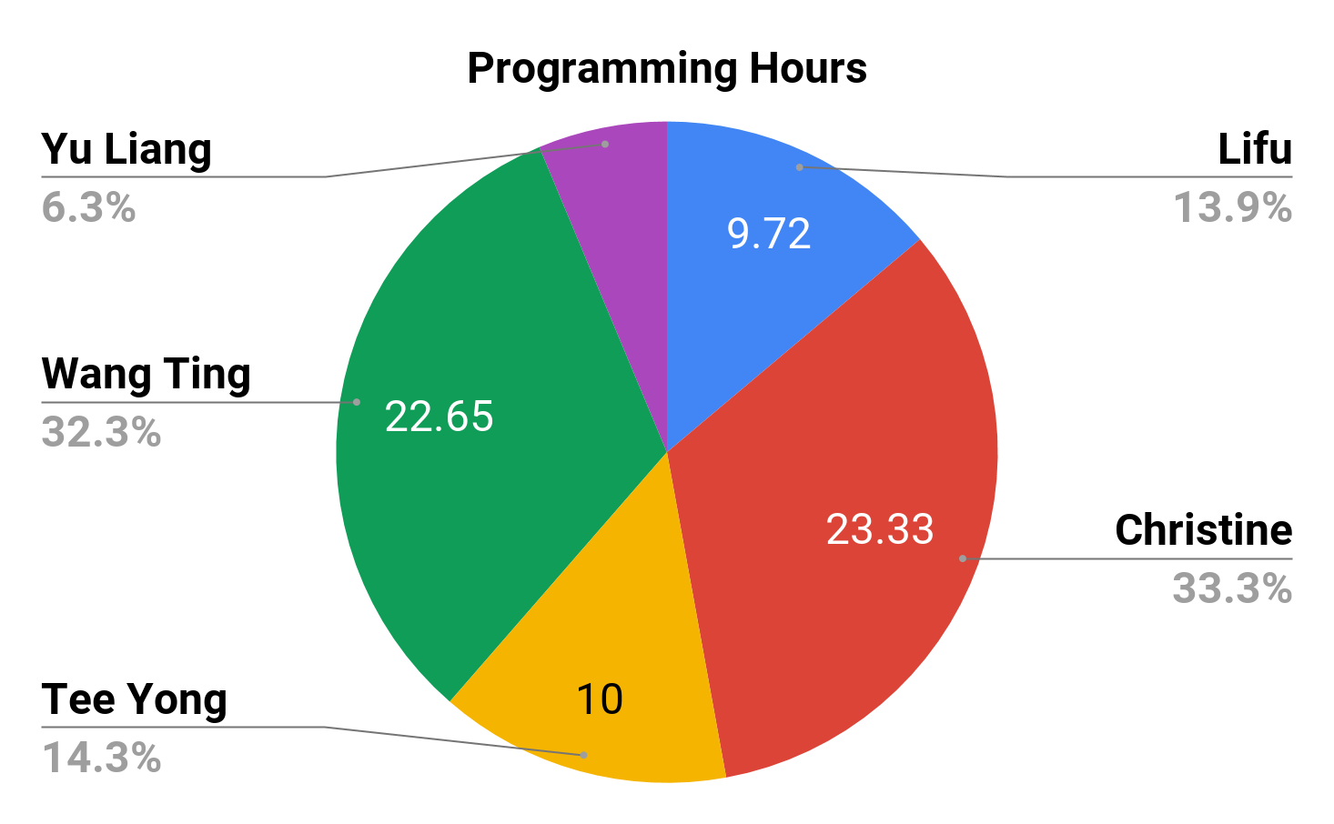
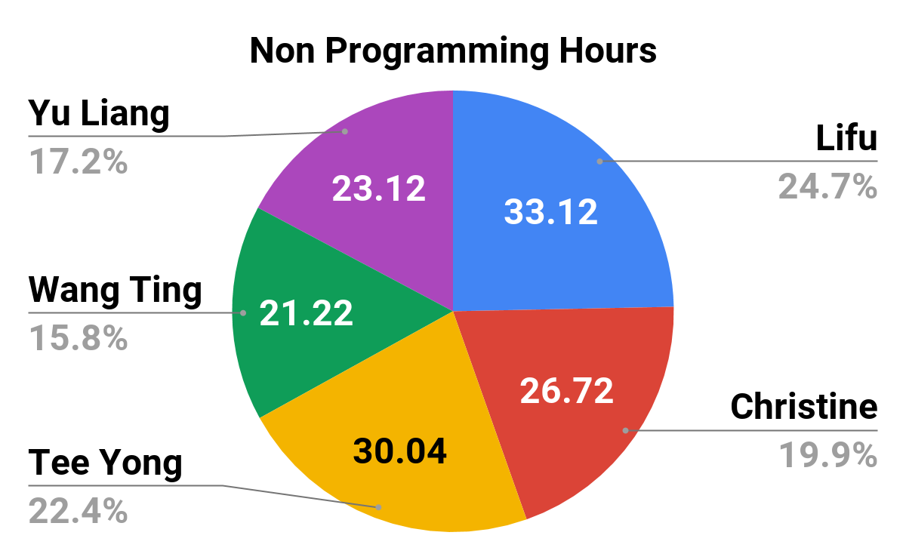
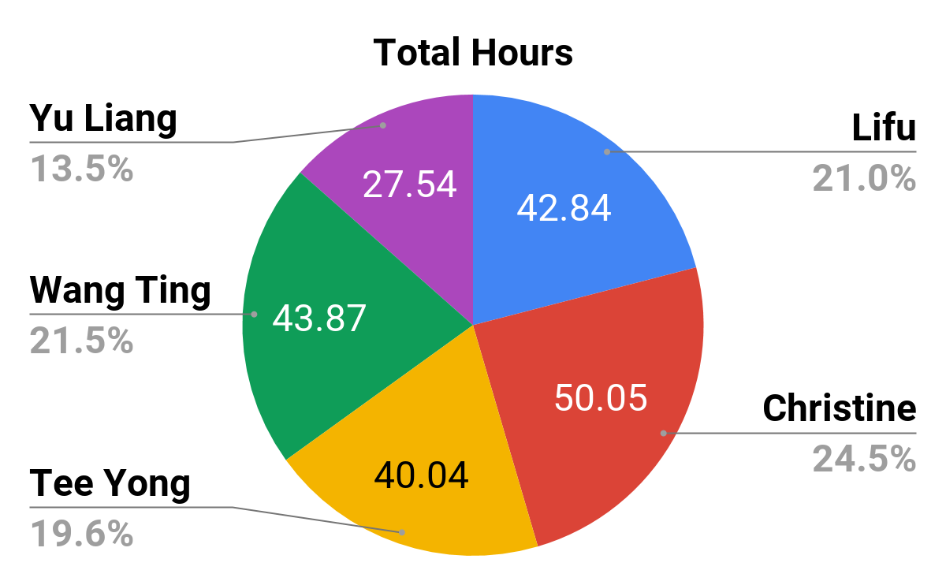
Breaking Down of Work (Iteration 5)
Iteration 5 | Team Member | Programming Hrs | Non Programming Hrs | Total Hours
 | Lifu | 9.72 (13.9%) | 33.12 (24.7%) | 42.84(21.0%)
 | Christine | 23.33 (33.3%) | 26.72 (19.9%) | 50.05 (24.5%)
 | Tee Yong | 10 (14.3%) | 30.04 (22.4%) | 40.04 (19.6%)
 | Wang Ting | 22.65 (32.3%) | 21.22 (15.8%) | 43.87 (21.5%)
 | Yu Liang | 4.42 (6.3%) | 23.12 (17.2%) | 27.54 (13.5%)

Slide 22
Problems we faced tracking our schedule and how we overcame it
Updating schedule when plans changed is very tedious
Sometimes members forgot to update each other about change in plans, resulting in confusion

Slide 23
Bug Metrics

Slide 24
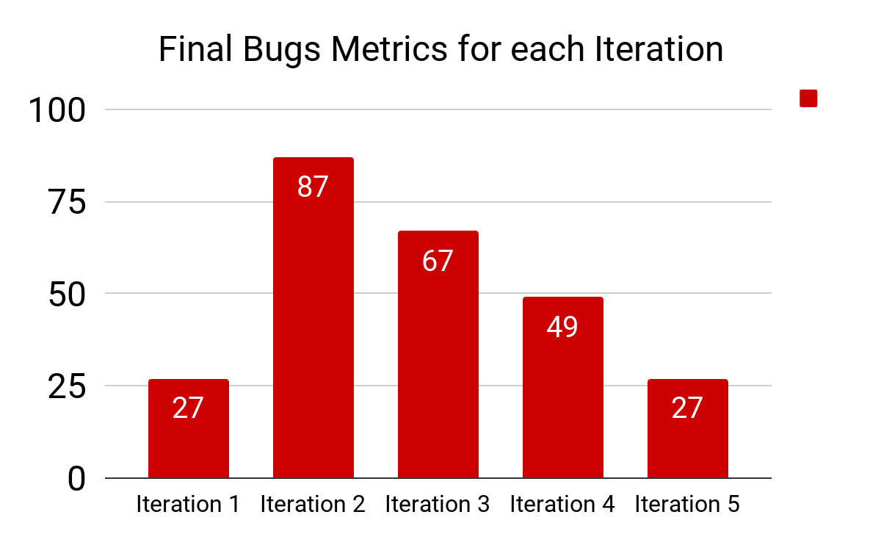

Bug Metrics from Iteration 1 - 5

Slide 25
How we used the metric to fix problems identified
For critical bugs, we stopped everything else immediately to resolve them first
For non-critical bugs, we checked if linked components were affected, then resolved them together when they exceeded 10 points on the metrics

Slide 26
Action taken when a critical problem arise
Alert team on Telegram
Immediately schedule debugging session with the pair in charge, get PM to join if necessary

Slide 27
Usage of Git

Slide 28
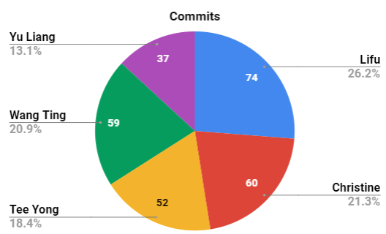
Github statistics
 | Commits Counts | Percentages
Lifu | 74 | 26.24%
Christine | 60 | 21.28%
Tee Yong | 52 | 18.44%
Wang Ting | 59 | 20.92%
Yu Liang | 37 | 13.12%
Notes:
Use data from commit logs and histories to substantiate our claim that we used Git consistently, correctly and evenly

Slide 29
Main Takeaways
Learn to plan early
Be meticulous
Teamwork is important
Communication is extremely important especially since everyone is working on the same repository
Expect the unexpected

Slide 30
Conflicts/ Issues Faced
Difficulty in scheduling pair programming sessions, especially after recess week
How we resolved:
Scheduled tasks on weekends / weekday nights
Adjusting pair programming plan

Slide 31
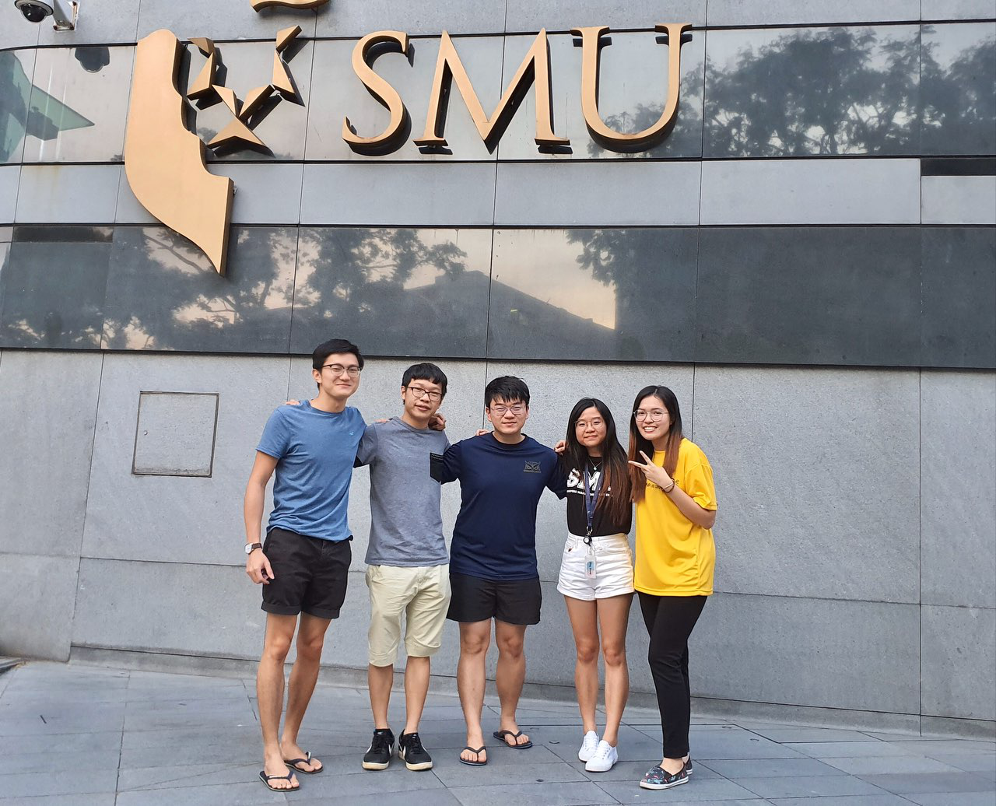
Interesting Facts
Notes:
(lets take a pic and insert here)
Lifu - can eat 40 mcnuggets at one go
Tee Yong - very humble. don’t know how to book GSR
Yu Liang - like to spoil market (agree). quite a good swimmer? can see IDP pitch video for reference. need a life guard? contact Yu Liang
Wang Ting - can stand and sleep
Christine - Design god, future UI UX designer feel free to contact Christine for any design queries

Slide 32

Thank you!

